Slide 1
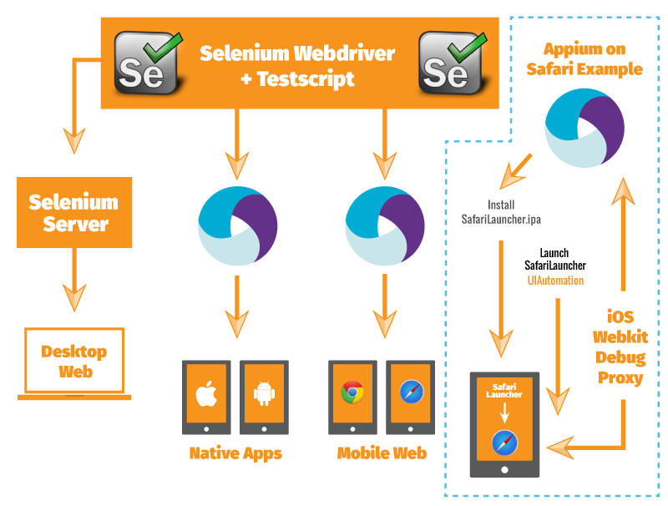
Appium set up on windows and mac for android and iOS devices
By:
Shruti Sinha

Slide 2

Android Setup
Steps to Configure Appium and Android for Mac / Windows:
1. Download Android SDK from the following link:
http://developer.android.com/sdk/installing/index.html
2. Run .exe file of Android Studio
3. Find the SDK location at c:/Users/user/AppData/Local/android/SDK
4. Download Java from following link:
http://www.oracle.com/technetwork/java/javase/downloads/jdk8-
downloads-2133151.html
5. Set system/environment variables path for both Java and Android so that your system
detects these locations
6. Download Eclipse from the following path: https://eclipse.org/downloads/
7. Launch Editor
8. Install ADT Plugin into eclipse using instructions below:
https://stuff.mit.edu/afs/sipb/project/android/docs/sdk/installing/installing-adt.html
9. To recognize ADT plugin, do the following settings in Android Studio Manager:
Open Custom perspective and make Android, AVD manager Enable and set the path of SDK
location in Preference window

Slide 3
10. Create Andorid Virtual Device (click on andorid phone icon on the top of Eclipse and follow the instruction, though, I would advise not to use Android emulators. Rather use actual device).
11. Download .net framework 4.5 or above if you don’t have it installed
12. Install Appium server from the link (http://appium.io/downloads.html) Please note:
13. Download (Appium and Selenium) Jars
14. Create a basic Java project using the above Jar files
15. You must Enable USB debugging on your device (that is connected with your PC/MAC).
16. Run to get latest adb on bash $brew install android-platform-tools
17. Run $adb services command to make sure your device is attached with adb server
18. Add Vysor (a chrome add-on) to have a better view of your device on monitor.
19. You can launch UI Automator Viewer to inspect the elements. Launch UI Automator by running following command (make sure your device is connected): $ uiautomatorviewer
If you need additional help, check this page:
https://nishantverma.gitbooks.io/appium-for-android/content/index.html

Slide 4

iOS Setup
Setting up Appium for iOS devices:
You must use Bash command line to run scripts to do many of the setups.
First, install npm appium: $ npm install -g appium
Check installation by running: appium -v
Install iOS debug proxy tool: $ brew install ios-webkit-debug-proxy
Install Device installer: $ brew install --HEAD ideviceinstaller
Install Node.js from following location: https://nodejs.org/en/
And then…run following command: $ npm install wd

Slide 5
Do following on command line:
$ cd ~
$ sudo apt-get install autoconf automake libusb-dev libusb-1.0-0-dev libplist-dev libplist++-dev usbmuxd libtool libimobiledevice-dev
(above command might not work but no worries, keep going with following commands)
$ git clone https://github.com/google/ios-webkit-debug-proxy.git
$ cd ios-webkit-debug-proxy
$ ./autogen.sh
$ make
$ sudo make install
Things you should absolutely do not forget while automating safari browser:
1. Enable UiAutomation in required device (inside device).
2. Enable Web inspector for safari in settings (inside device – browser).
3. Start the ios_webkit_debug_proxy from terminal with ios_webkit_debug_proxy -c <UDID:
27753> -d (do not close this Terminal window)
4. Start appium server: appium -U <UDID> (run this on a separate Terminal window)
5. Run Appium doctor to make sure you’ve setup all correctly: $ appium-doctor
If above returns error, perhaps you’ve not setup your environment variables yet. See how to setup environment variables (for Mac machine)

Slide 6
How to chage UDID (when needed):# change the udid> ./bin/ios-webkit-debug-proxy-launcher.js -c <UDID>:27753 -d
Error handling:
If you see error like port is not available, kill Appium using following command: $ killall -9 node
Then quit terminal window(s) and start again.
SafariLauncher:
Download SafariLauncher from Git (https://github.com/budhash/SafariLauncher),
Open SafariLauncher.xcodeproj file with XCode,
Add a bundle ID in the project (create a bundle ID in Apple Dev account and attach)
When you save the project, it saves to: /Users/yourfirstname.lastname/Library/Developer/Xcode/DerivedData/SafariLauncher-gwccbbvoxvsenlejxfuzmzetqssp/Build/Products/Debug-iphoneos/SafariLauncher.app
Quick Check:
To make sure your SafariLauncher is ready, run it from Xcode (while device is connected) and make sure it gets installed into the device.

Slide 7
Specific Setups:
To do any specific setup, you can use following commands:
Run:
node /Applications/Appium.app/Contents/Resources/node_modules/appium/bin/appium.js
–address 127.0.0.1
–port 4723 –full-reset
–device-name “iPhone 6”
–platform-name iOS
–platform-version “8.3”
–app “/My.app”
–browser-name iOS -l
Starting Appium via command line (make sure your GUI is not running):
$ appium –port 4723 –safari
Or, you can run Appium by running following command:
$ appium &

Slide 8
Caution:
Make sure you opened two terminal windows; one for Appium to run and other one is for ios_webkit_debug_proxy to run. Make sure you keep them opened all the time, so do XCode.
Most of the time you will encounter issue like your device could not bind to port 27753. You need to killall -9 node to kill the Appium server. Now, quit Terminal and start from beginning again.
You must run following commands on two Terminal bash window in this order:
ios_webkit_debug_proxy -c <UDID:27753> -d
appium -U <UDID>
To make sure your proxy is running on port 27753, open a browser and type on address bar http://127.0.0.1:27753. Hit enter and you should be able to see your device connected.

Slide 9

Capabilities
Code Example (Desired Capabilities):
Desired Capabilities are options that you can use to customize and configure a browser sessions.
Mostly used Capabilities:
automationName
platformName
platformVersion
app
browserName
newCommandTimeout
autoLaunch
orientation
deviceName
**Please note: All DesiredCapabilities declarations for native apps testing should be under @Test annotation.
**Please note: driver.quit() function does not work when you test Safari on pysical iOS device. Use driver.close() in @Test, not @AfterTest

Slide 10
DesiredCapabilities capabilities = new DesiredCapabilities();
capabilities.setCapability(“deviceName“, “xx-xxxxx“); //Your device Name
capabilities.setCapability(“platformName“, “Android“); //Or iOS
capabilities.setCapability(CapabilityType.BROWSER_NAME, “Chrome“); // If Safari, use name safari
capabilities.setCapability(“platformVersion“, “5.0.2“); //This is your OS version of the device
capabilities.setCapability(“appPackage“, “com.android.chrome“); //For Chrome in Android
capabilities.setCapability(“appActivity“,”com.google.android.apps.chrome.ChromeTabbedActivity“); //For Andorid
driver = new AndroidDriver(new URL(“http://127.0.0.1:4723/wd/hub“), capabilities);

Slide 11

Environment Variables
SettingUp Environment Variables (Mac)
Open your bash profile as: $ open .bash_profile
Copy / paste following (blue text only) on the bash_profile and save:
Followings are for Appium setup
export ANDROID_HOME=/Users/YourfirstName.YourLastName/Library/Android/sdk
export PATH=$ANDROID_HOME/platform-tools:$PATH
export PATH=$ANDROID_HOME/tools:$PATH
export JAVA_HOME=$(/usr/libexec/java_home)

Slide 12
Once done (above), run bash command: $ appium-doctor
If setups are successful, you should see a report like following:
iOS and Android setup-check
info AppiumDoctor ### Diagnostic starting ###
info AppiumDoctor ? Xcode is installed at: /Applications/Xcode.app/Contents/Developer
info AppiumDoctor ? Xcode Command Line Tools are installed.
info AppiumDoctor ? DevToolsSecurity is enabled.
info AppiumDoctor ? The Authorization DB is set up properly.
info AppiumDoctor ? The Node.js binary was found at: /usr/local/bin/node
info AppiumDoctor ? HOME is set to: /Users/nayemul.chowdhury
info AppiumDoctor ? ANDROID_HOME is set to: /Users/nayemul.chowdhury/Library/Android/sdk
info AppiumDoctor ? JAVA_HOME is set to: /Library/Java/JavaVirtualMachines/jdk1.8.0_73.jdk/Contents/Home
info AppiumDoctor ? adb exists at: /Users/nayemul.chowdhury/Library/Android/sdk/platform-tools/adb
info AppiumDoctor ? android exists at: /Users/nayemul.chowdhury/Library/Android/sdk/tools/android
info AppiumDoctor ? emulator exists at: /Users/nayemul.chowdhury/Library/Android/sdk/tools/emulator
info AppiumDoctor ### Diagnostic completed, no fix needed. ###
info AppiumDoctor
info AppiumDoctor Everything looks good, bye!

Slide 13

Inspect Elements
It is sometimes difficult to inspect page elements for mobile or Native app to capture object properties in the device.
Here are few tricks how you can do that:
For IOS
From iPhone > Settings > Safari > down to Advanced hit > next screen turn ON Web Inspector
Connect your iPhone to your mac using USB cable. This will send a pop up on your phone to trust. Trust it
Now, Open safari on your Mac (computer)
Next, from Menu, click Safari > Preferences
On this window, check ‘Show develop menu in menu bar’
Once you do the above, you should see ‘Develop’ menu on the top menu (apple menu) for the browser
Now on your iPhone, open website on safari browser that you like to inspect elements
Go back to “Develop” and click on it. Notice, your iPhone is recognized. Click on your iPhone > Page that you want to inspect. Click the page link.

Slide 14
Alternate inspection (iOS):
Launch ios_webkit_debug_proxy:
ios_webkit_debug_proxy -d
Go to http://localhost:9221/
You should see “iOS Devices” and nothing else
Connect iPhone
You should see “1. localhost:9222 – iPhone” where localhost:9222 is a hotlink
Disconnect iPhone.
Refresh browser. localhost:9222 is no longer a hotline
Reconnect iPhone
Refresh browser. Hotlink is back.
Click link and see: “Inspectable pages for iPhone:”
Launch Safari on iPhone and go to google
Reload browser on Mac and see a line added to the page: “1. https://www.google.com/” where https… is a hotlink
Click hotline and you will see ios_webkit_debug_proxy tool, which you can use like Firebug to inspect elements on the page.

Slide 15
For Android:
Go to command line and type the following and hit enter:
uiautomatorviewer
The above action will open Editor. Click each object from left to see the properties and values.
As alternate, you can use browser to inspect elements. Please go to the link below to get the instruction:
https://developer.chrome.com/devtools/docs/remote-debugging

Slide 16


